Slide 1
Hi presenter! Read me before using!
This webinar resource is almost ready for you to use! Be sure to:
Look through and add custom information
Slide #2- Title slide (date)
Slide 3- Presenter information
Slide 5- Housekeeping items
Slides 10-16- How-to Slides (remove options not available in your District, if applicable)
Slide 19- Resources (optional)
Slide 23- Thank you slide
There are presenter notes to help guide you- feel free to edit these
This resource can be customized. Here are some examples of how you can personalize this slide deck to suit the needs of your educators and staff:
Replace our images with screen shots from your environment
Read through slides and ensure terms and jargon will resonate with your board policies/ tool names in your Brightspace environment (i.e. Assignments vs Dropbox, Announcements vs News)
Add additional information to slides specific to your district, including how this helps meet district goals, improvements plans, strategic plans etc
Include your district logo on slides or change the colors used to match your district branding

Slide 2
Video Options in Brightspace
<insert date>
© 2020 D2L Corporation
Notes:
This webinar will cover the various video tool options in Brightspace

Slide 3
Presenter Name Title Company/Organization
@Twitter handle

Slide 4
Agenda
What video options are available in Brightspace?
How can I use the video tools in Brightspace?
Resources
Notes:
Today, we’ll be discussing the various video tool options in Brightspace. Our agenda for today is:
What video options are available in Brightspace?
How can I use the video tools in Brightspace?
Resources

Slide 5
Housekeeping Items
How can people ask questions?
Webinar recording and slide deck will be available on ___________
Information about attendance
Notes:
This slide is for you to add Housekeeping Items particular to your District and this session.
It may include information about how attendees can ask questions, how they can access the webinar information after the session, or even how they confirm their attendance for the session (if applicable)

Slide 6
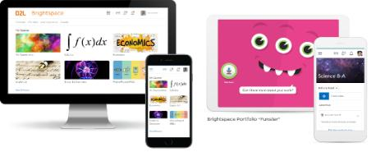
Understanding some terms...
Company:
D2L
Product:
Brightspace
Online Community:
Brightspace Community
Notes:
This is a useful slide to ensure everyone understand the terminology used when discussing Brightspace.
It would be helpful to personalize this slide to include any District specific information, especially if your District as a different branding for “Brightspace.” This will help attendees when they see resources about “Brightspace” to know that this is what your District is using as well but has branded differently.

Slide 7
Exceptional student experiences and outcomes
Equity for all students
Meaningful connections with parents
Why Educators
Brightspace
Tools teachers love
Worry-free technology
More partner, less vendor
Notes:
Here’s why educators love Brightspace

Slide 8
Video Options in Brightspace:
Virtual Classroom
Video Assignment
MS Teams
Google Meet
Video Note
Purpose:
Purpose:
Purpose:
Purpose:
Purpose:
Allows you and students to record up to 30 mins of video- can be used wherever the “Insert Stuff Button” can be found (Announcements, Content, Assignments, Discussions, Long answer quiz questions)
Virtual conferencing space, including a virtual white board.
*please note recordings delete after 14 days in Freemium version. They can be downloaded and uploaded to your Content area.
Allows students to complete a video assignment (up to 120 mins). Also allows for educator to give video instructions and comments
Create an MS Teams Meeting link right in Brightspace
Create a Google Meet right within Brightspace!
Notes:
Use this slide to introduce some of the tools or features you will discuss and cover during the demo
**Be sure to confirm the terminology on this slide matches the language terms used in your District’s Brightspace environment (i.e. Assignments vs Dropbox etc)

Slide 9
Video Tool Options Demo
Learning Objectives:
You will be able to:
Use Video Note
Use Virtual Classroom
Make a Video Assignment
Generate an MS Teams Meeting/Google Meet link in Brightspace
Notes:
Next we’ll head into a live demo to show you video tool options in Brightspace
Note: The learning objectives on this slide can be personalized to meet the needs for your District and attendees

Slide 10
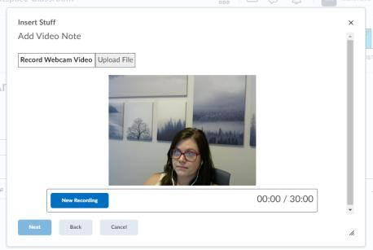
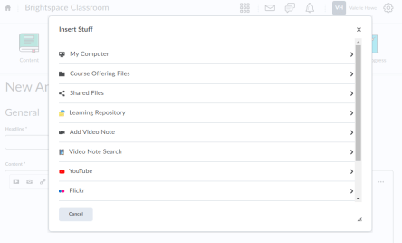
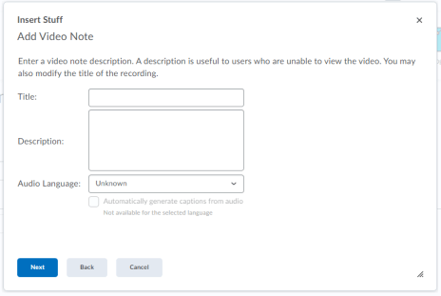
Create a Video Note
1
2
From Insert Stuff, choose “Add Video Note”
Click “New Recording” (you might need to give permission for your microphone and webcam first!) Stop the recording when finished and click “Next”
Optional: Give your Video Note a title and description. This will help students using assistive technologies! You may also choose to enable closed captioning
Click “Next” and then “Insert”
3
4
Notes:
This slide can serve as a resource for your educators & staff after the webinar. It can also serve to help with step by steps instructions if doing a live demo is not possible.
Another option is to let your attendees know these how-to slides are in the slide deck for them to reference, and hide the remaining slides during the live webinar, and unhide them prior to send the slide deck to your attendees after the webinar.

Slide 11
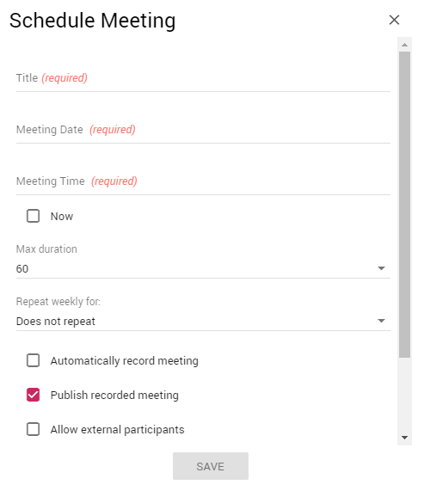
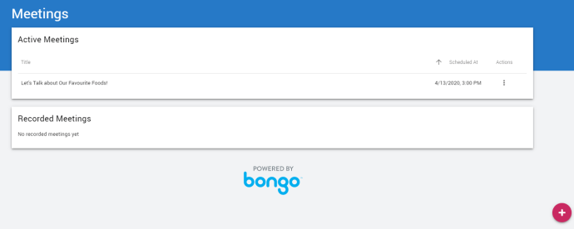
Create a Virtual Classroom
3
1
2
Click on “Virtual Classroom” on your Navbar
Click the pink add button at the bottom right-hand corner
Fill out meeting details
Click “Save”
4
Notes:
This slide can serve as a resource for your educators & staff after the webinar. It can also serve to help with step by steps instructions if doing a live demo is not possible.
Another option is to let your attendees know these how-to slides are in the slide deck for them to reference, and hide the remaining slides during the live webinar, and unhide them prior to send the slide deck to your attendees after the webinar.

Slide 12
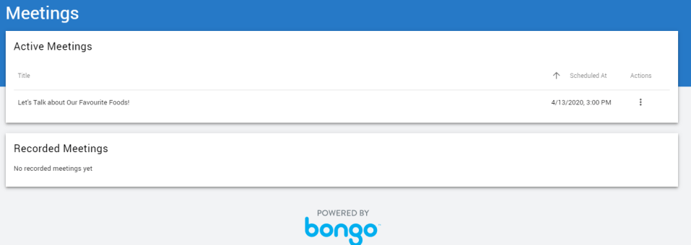
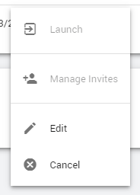
Launch a Virtual Classroom Meeting
1
2
Click on the “Actions”
Click “Launch”
Notes:
This slide can serve as a resource for your educators & staff after the webinar. It can also serve to help with step by steps instructions if doing a live demo is not possible.
Another option is to let your attendees know these how-to slides are in the slide deck for them to reference, and hide the remaining slides during the live webinar, and unhide them prior to send the slide deck to your attendees after the webinar.

Slide 13
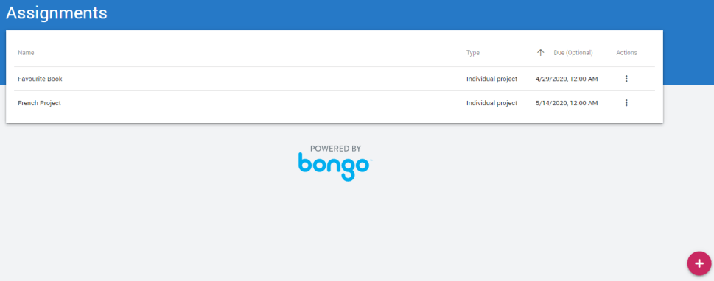
Create a Video Assignment (1/2)
2
1
Click on the pink add button on the bottom right-hand corner.
Click the blue Video Assignment button
Notes:
This slide can serve as a resource for your educators & staff after the webinar. It can also serve to help with step by steps instructions if doing a live demo is not possible.
Another option is to let your attendees know these how-to slides are in the slide deck for them to reference, and hide the remaining slides during the live webinar, and unhide them prior to send the slide deck to your attendees after the webinar.

Slide 14
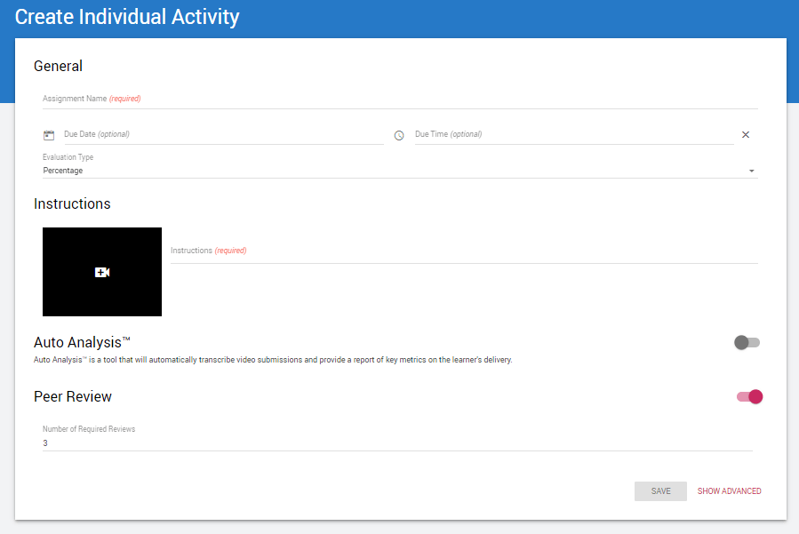
Create a Video Assignment (2/2)
3
Fill out the assignment information including: Assignment Name, Due Date, Due Time, Evaluation Type, Video and/or Instructions
Click “Save”
4
Notes:
This slide can serve as a resource for your educators & staff after the webinar. It can also serve to help with step by steps instructions if doing a live demo is not possible.
Another option is to let your attendees know these how-to slides are in the slide deck for them to reference, and hide the remaining slides during the live webinar, and unhide them prior to send the slide deck to your attendees after the webinar.

Slide 15
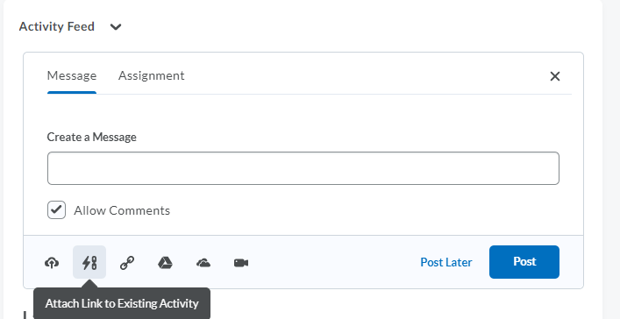
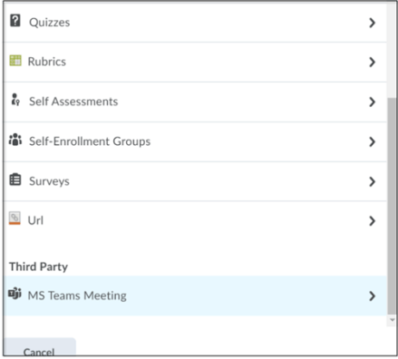
Create a MS Teams Meeting
1
2
From Activity Feed, click the “Attach Link to Existing Activity” option (in other tools, such as Announcements, use Quicklinks)
Select the MS Teams Meeting option and fill in the meeting information. Click “Save”
Continue filling out your Activity Feed post and post immediately or schedule to post prior to your meeting time.
Notes:
This slide can serve as a resource for your educators & staff after the webinar. It can also serve to help with step by steps instructions if doing a live demo is not possible.
Another option is to let your attendees know these how-to slides are in the slide deck for them to reference, and hide the remaining slides during the live webinar, and unhide them prior to send the slide deck to your attendees after the webinar.

Slide 16
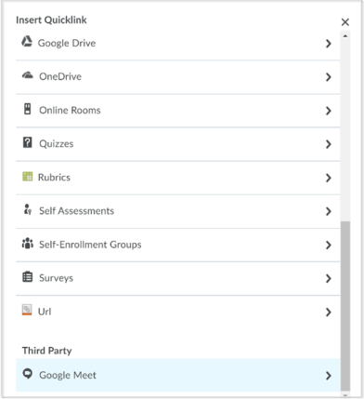
Create a Google Meet
1
2
From Activity Feed, click the “Attach Link to Existing Activity” option (in other tools, such as Announcements, use Quicklinks)
Select the Google Meet option and fill in the meeting information. Click “Save”
Continue filling out your Activity Feed post and post immediately or schedule to post prior to your meeting time.
Notes:
This slide can serve as a resource for your educators & staff after the webinar. It can also serve to help with step by steps instructions if doing a live demo is not possible.
Another option is to let your attendees know these how-to slides are in the slide deck for them to reference, and hide the remaining slides during the live webinar, and unhide them prior to send the slide deck to your attendees after the webinar.

Slide 17
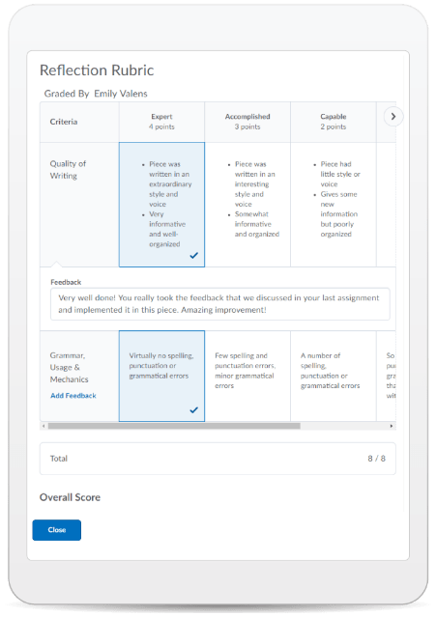
Learning Objectives:
You will be able to:
Use Video Note
Use Virtual Classroom
Make a Video Assignment
Generate an MS Teams Meeting/Google Meet link in Brightspace
© 2020 D2L Corporation
Notes:
This slide can serve as a resource for your educators & staff after the webinar. It can also serve to help with step by steps instructions if doing a live demo is not possible.
Another option is to let your attendees know these how-to slides are in the slide deck for them to reference, and hide the remaining slides during the live webinar, and unhide them prior to send the slide deck to your attendees after the webinar.

Slide 18
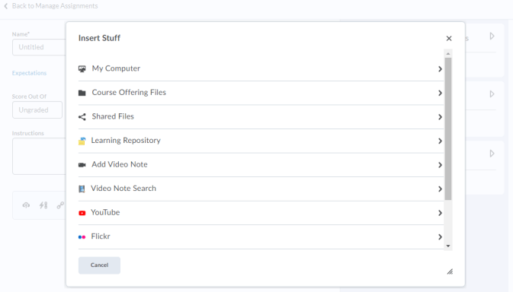
Give This a Try!
Make a video note when giving instructions for an assignment.
Create a MS Teams meeting or Google Meet from Activity Feed
Notes:
Looking on how to get started? Give one of these take away activities a try!

Slide 19
Resources
Brightspace Quick Start Guide K-12
Create a New Discussions Forum
Create a New Discussion Topic
Create a New Quiz
D2L Parent and Guardian Support Site
Discussions- Restricting Access
Quizzes- Attach a Release Condition
Quizzes- Grant a User Special Access
Notes:
This page has resources specifically on Quizzes, Discussions Release Conditions and Special Access. This is also where District specific resources can be added.

Slide 20
Tutorial Videos
Communication and Collaboration | Organizing Course Materials | Documenting Student Learning | Feedback & Assessment
Announcements Activity Feed -Add Attachments and Links to Posts -Create an Assignment Post in Activity Feed -Customize Notifications for Activity Feed -For posting a message -Optimize Activity Feed Discussions | Content/Lessons Tool -Getting Started with Lessons for Instructors -Lessons: Add a New Unit and Lesson -Lessons: Add New Materials -Lessons: Reorder Units, Lessons, Folders, and Materials -Lessons: Attach a Release Condition Groups -Creating Groups -Creating Individual Student Groups -Creating Unique Learner Pathways | Brightspace Portfolio -Review and Approve Portfolio Items -Oversee and View Individual Portfolios -Brightspace Portfolio: Bring Your Own Device (for learners) -Portfolio AT HOME Assignments Discussions Quizzes -Quiz Question Converter | Rubrics -Create an Analytic Rubric -Create a Holistic Rubric Grades -Entering Grades -Associate an Activity with a Grade Item -Create a Grade Scheme Standards/Expectations -Standards: Import Standards from Course Admin Assessing or Evaluating Against Expectations Quick Eval
Notes:
There are also many quick tutorial videos available! These resources are organized pedagogically. Every underlined item is linked to a tutorial video

Slide 21
Thank you!
@Twitterhandle
#districthashtag
#D2LK12
Notes:
Thank you so much for joining us today!
If you have any questions or need any help, please consult or contact:
We’d love to see all the awesome ways you’re using Brightspace! Use our District hashtag and/or #D2LK12 so we can all learn from each other and share great ideas of how to use Brightspace to support teaching, learning and, most importantly, our students!

